Slide 1
Tasks For Train In OpenEMR

Slide 2
Installation of OpenEMR
Download The OpenEMR Latest Package & Extract The Devlopment Folder.
File Path:Var/www/html/openemr.
Run Browser on Below Address
http://localhost/interface/login/login.php?site=default
Username = administrator
Password = administrator

Slide 3
Reinstall OpenEMR
Reinstall OpenEMR with Existing CodeBase.
Openemr sites default sqlconf.php
Change The $config = 1; TO $config = 0;
Then Install OpenEMR On New DataBase With
Existing CodeBase.

Slide 4
SQL Upgrade
Refer OpenEMR Community To Find Below URL To Upgrade SQL.
http://localhost/sql_upgrade.php
Add custom_upgrade.sql File on sql_upgrade Dropdown.
custom_upgrade.sql file makes
Create Table
Insert Record
Update Record

Slide 5
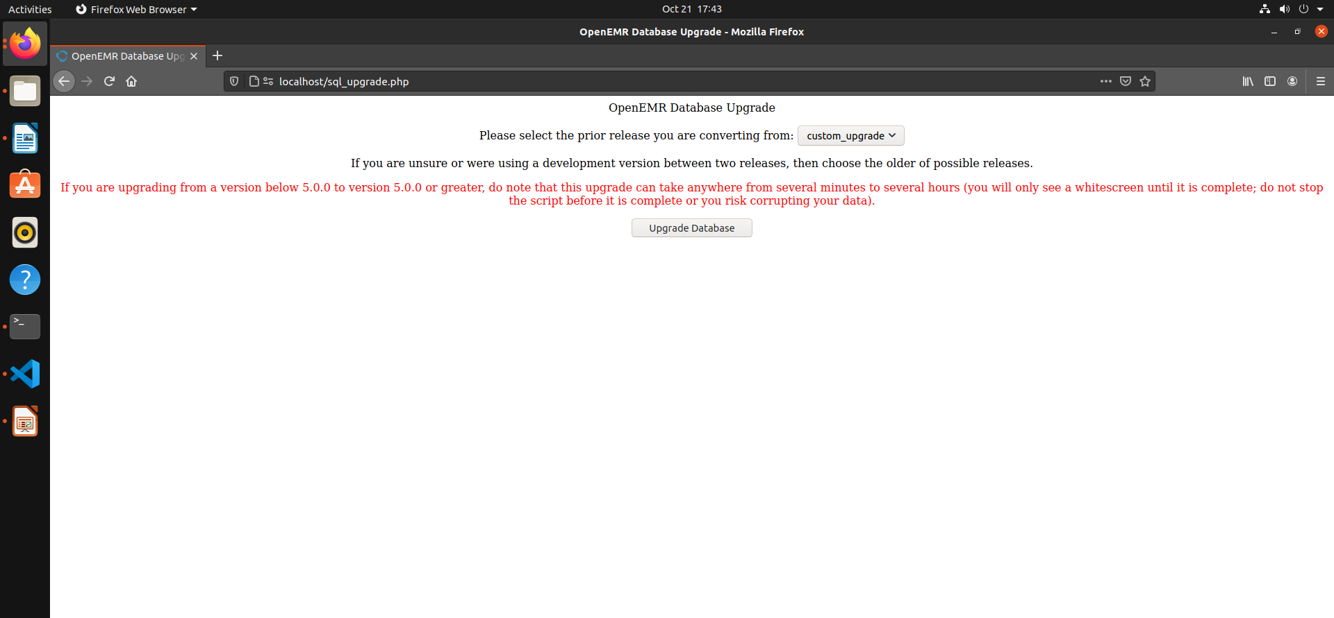
Drop Column

Slide 6
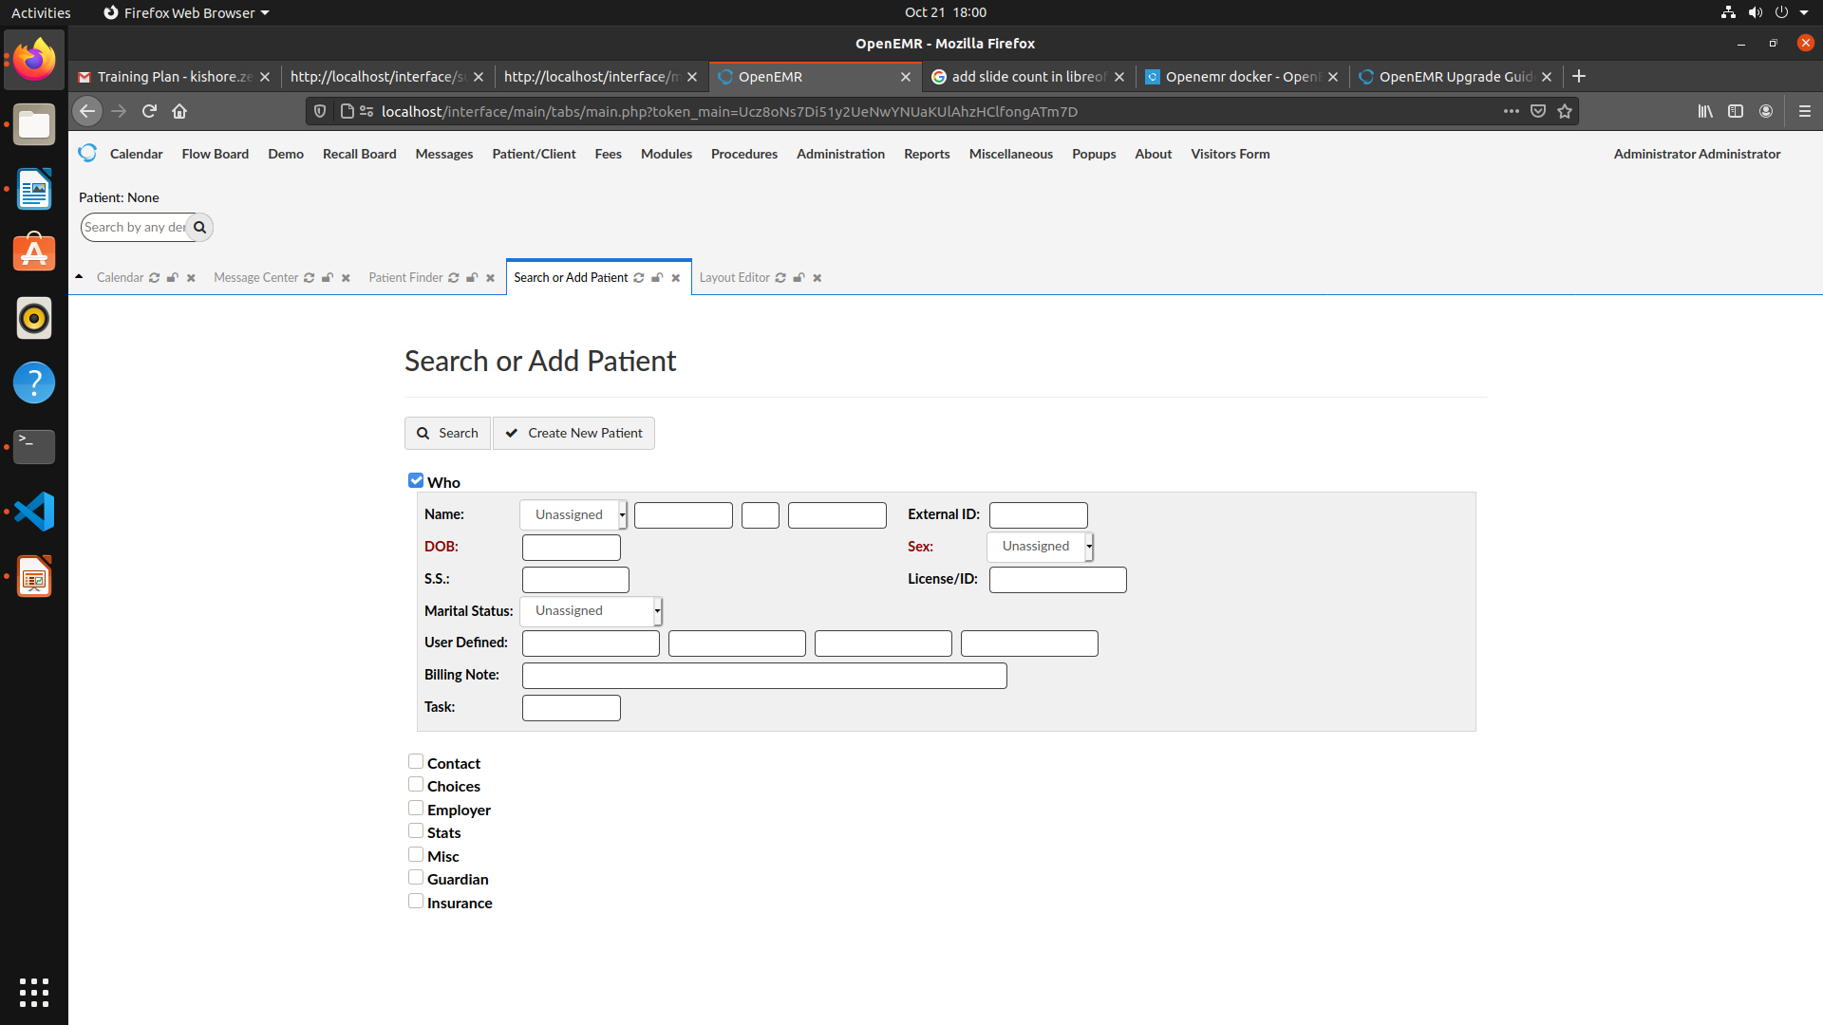
Patient Demographics
New Field Needs To Be Included In Patient Demographics.
Administration Layouts Demographics
Add Field Name Was Task. Save Changes

Slide 7
Patient Finder
In Patient Finder Need To Be Include The Column “Gender”.
Administration Lists Patient List Columns.
Add Column Name Was Gender. And Gender ID was matching on List_option table option id Was Match To Print the data in Gender Column.

